Slide 1

TEETHER: Gnawing at Ethereum to Automatically Exploit Smart Contracts
A PRESENTATION BY
SANIDHYA SHARMA
ANURADHA RAMCHANDRAN

Slide 2
INTRODUCTION
A blockchain is a data structure that is publicly verifiable and contains a record of all transactions.
This data structure is maintained by a peer-to-peer network, and all nodes of this network follow a consensus protocol.
Ethereum has emerged as one of the most widely used.
It currently holds the position of the second largest cryptocurrency in terms of overall market value, as of mid-2018.
While Bitcoin enables the definition of basic checks to be conducted during transaction processing, Ethereum permits these regulations to be articulated in a Turing-complete language.
This feature positions Ethereum as the leading platform for executing smart contracts.

Slide 3
BACKGROUND
As Ethereum's consensus protocol allows rules to be specified in a Turing-complete language, it is the leading platform for smart contracts.
However, this increased complexity also means a higher risk of errors compared to the simple checks used in Bitcoin.
Additionally, smart contracts in Ethereum are immutable and cannot be modified once deployed.
This results in a unique link between software vulnerabilities and financial loss.
In fact, since the inception of Ethereum in 2015, several cases of smart contract vulnerabilities have been observed, causing a loss of tens of millions of USD.

Slide 4
EThereum VIrtual machine (EVM)
160-bit account address are mapped to their Ethereum balance (public ledger).
Smart contracts are executed in a stack based virtual machine called EVM.
Word size = 256 bit.
Ethereum's state is a large data structure which holds not only all accounts and balances, but a machine state, which can change from block to block according to a predefined set of rules, and which can execute arbitrary machine code.
EVM cannot handle floating point values.
1 Ether = 10^18 Wei.
Ethereum also provides a byte-addressable memory which is set to zero at beginning of contract execution.

Slide 5
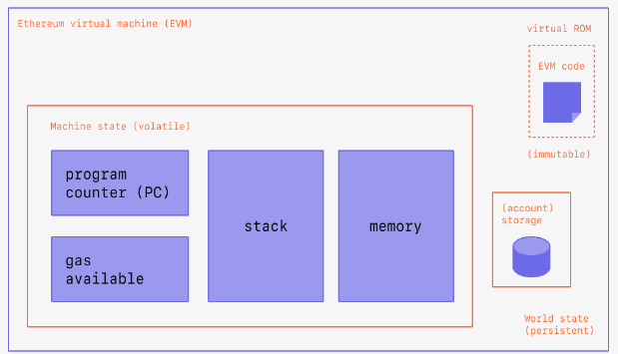
Ethereum Virtual machine (evm)
Apart from arithmetic & control-flow EVM provides the following types of special instructions:
Access fields of current transaction.
Modify contract’s private storage.
Query current state of blockchain.
Create further transactions.

Slide 6
Smart contracts and solidity
Solidity is a high-level language similar to JavaScript.
A smart contract is a special type of Ethereum account that is associated with code.
Smart contracts written in Solidity are compiled to EVM bytecode.
To create a smart contract, we send a special transaction to the zero address.
After creation, the code of a contract is immutable, i.e., it cannot be updated or patched.
It can hold a balance of Ether, which is a type of Ethereum cryptocurrency.
It has a private storage of key value pairs (256 bit each).
This means that it is cryptographically secured against modification by other accounts or contracts.

Slide 7
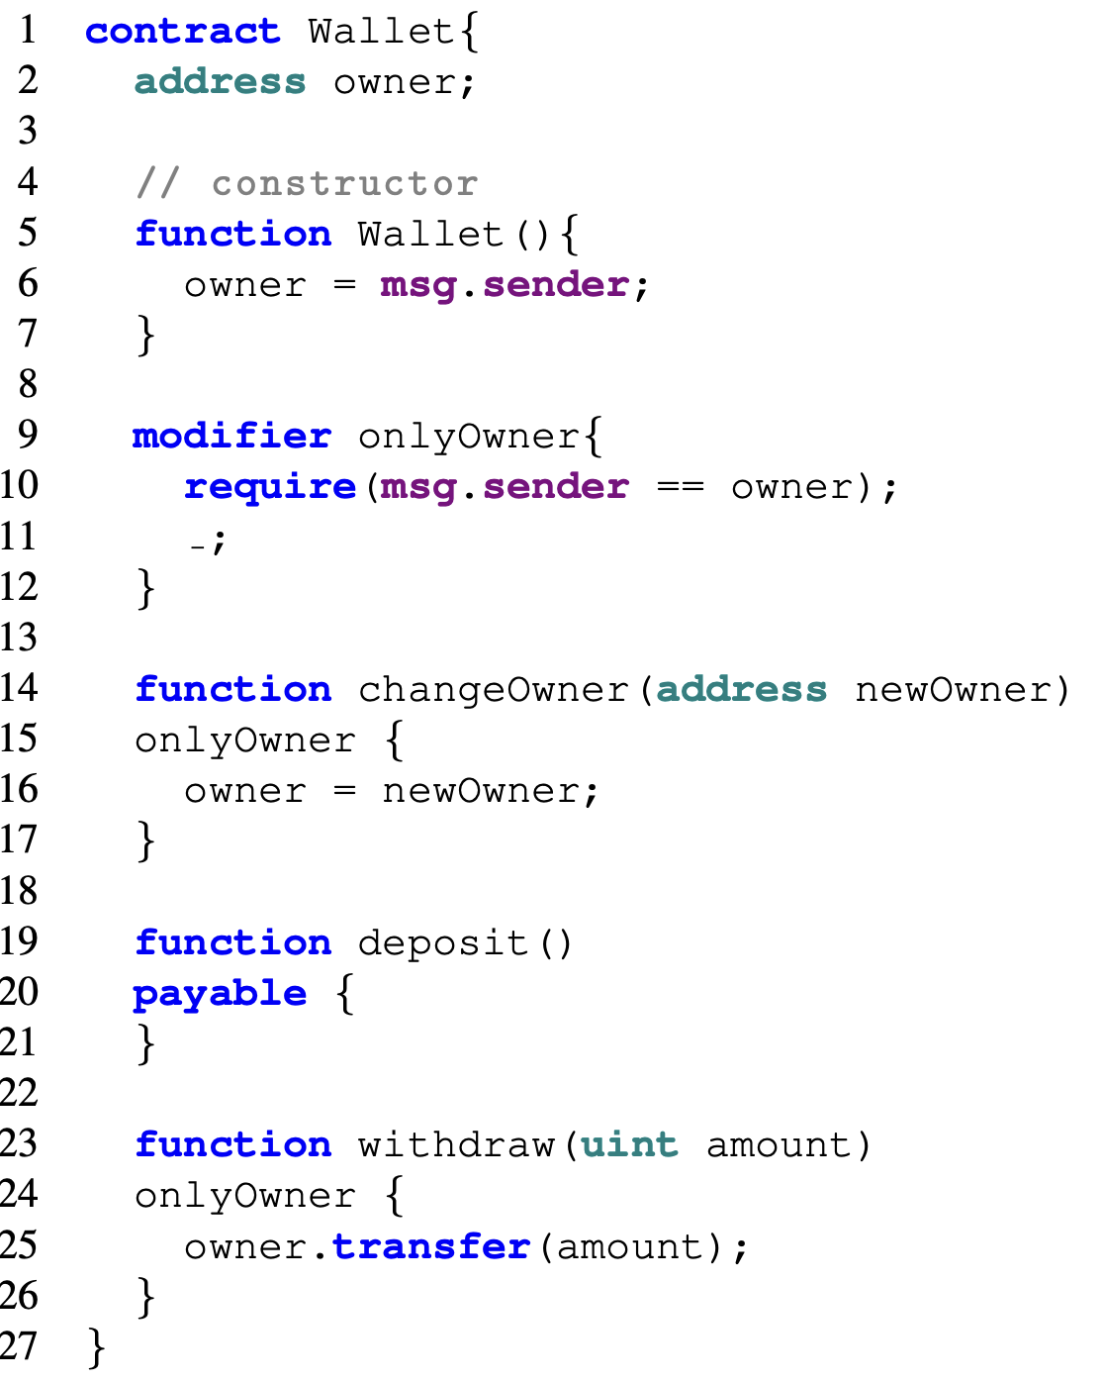
Solidity - The Wallet example
The address keyword is used to denote the address of the owner of the wallet.
The Wallet() constructor can be identified because it has the same name as the contract.
Modifier onlyOwner is a special function ending in “ _; ” allowing it to wrap other functions.
The deposit() function is used to add ether to the wallet.
The keyword payable allows the smart contract to receive and send ether.
The withdraw() function can allow the caller to transfer amount passed in the argument to the caller’s address.
The changeOwner() function can allow the caller to transfer ownership to some other owner.
changeOwner() and withdraw() use the onlyOwner modifier allowing only the creator of the wallet(msg.sender) to use these functions.

Slide 8
Problem statement
The problem statement of this paper is to develop a tool that performs automatic exploit generation of smart contracts to find vulnerabilities.
This tool allows the creation of an exploit for a contract given only its compiled bytecode.
The paper also describes a generic definition of vulnerable smart contracts, based on low-level EVM instructions.

Slide 9
Smart contract vulnerabilities
Smart contracts enforce control over who can interact with them. (E.g., msg.sender)
Therefore, a contract is vulnerable if it allows an attacker to transfer Ether from the contract to an attacker-controlled address.
The paper describes static analysis of code at instruction level to identify critical paths that can be used to steal Ether stored in a contract.
4 critical EVM instructions are required to extract Ether:
Direct value transfer:
1. CALL
2. SELFDESTRUCT
Code injection:
3. CALLCODE
4. DELEGATECALL

Slide 10
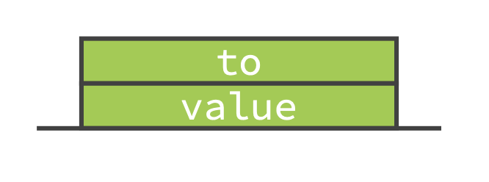
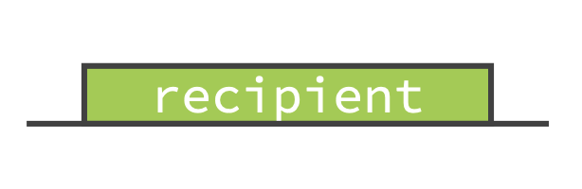
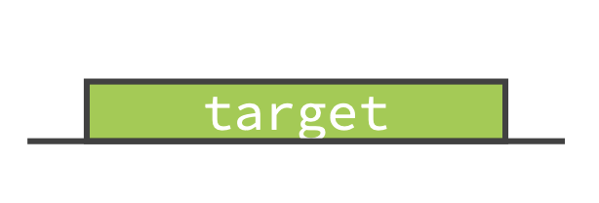
Critical Instructions
CALL
Regular transaction
Transfer value to to
SELFDESTRUCT
Contract destruction
Transfer balance to recipient
CALLCODE/DELEGATECALL
Execute code of target
Target contract can give CALL or SELFDESTRUCT to transfer value

Slide 11
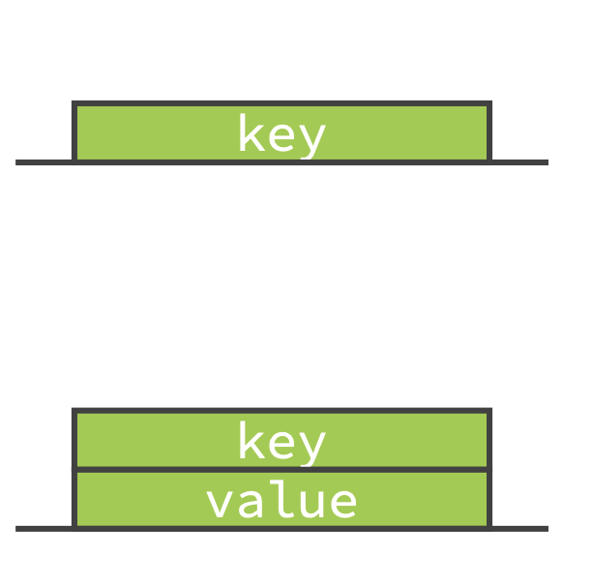
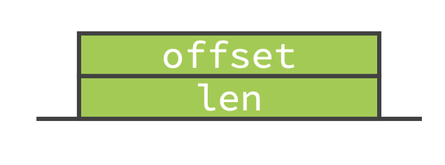
Critical Instructions
SLOAD
Load value for key
SSTORE
Store value at key
SHA3
Used to implement mapping in Solidity
Compute Keccak-256 hash over memory[offset: offset + len]

Slide 12
Defining Vulnerabilities
Critical Path: Potential execution trace leading to:
CALL instruction with non-zero value and externally controlled to address.
SELFDESTRUCT instruction with externally controlled recipient address.
CALLCODE/DELEGATE CALL where target can be externally controlled address.
Vulnerable State: A contract is in vulnerable state if a transaction can leads to the execution of a critical path
State Changing Path: Potential execution trace that contains at least one SSTORE instruction
State Changing Transaction: A transaction whose execution trace is a state changing path
Vulnerable Contract: A contract is vulnerable if there exists a sequence of state changing transaction that leads to a vulnerable state

Slide 13
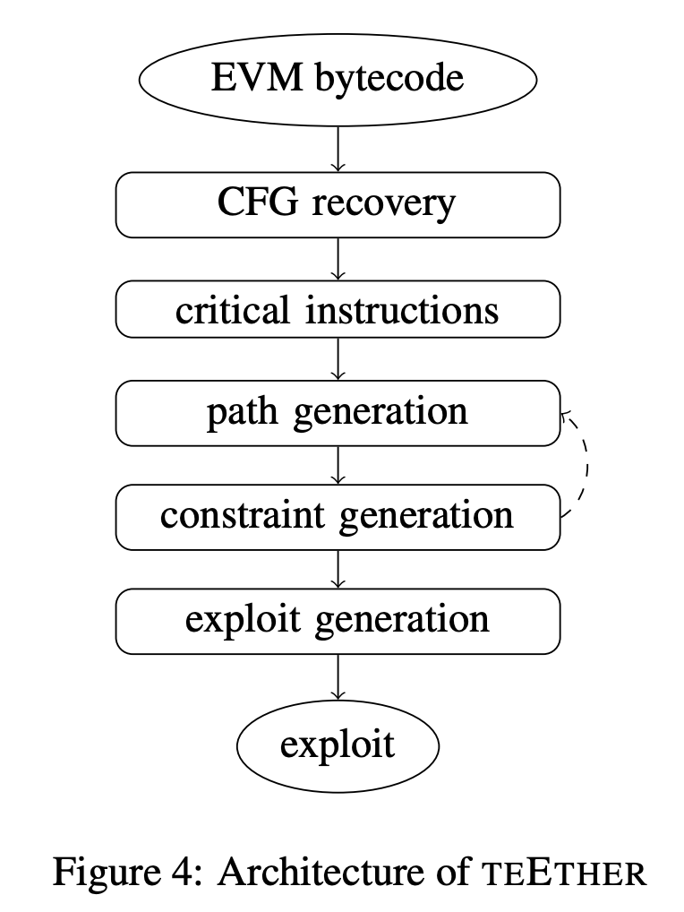
Automatic Exploitation
The process starts with the disassembly of the EVM bytecode and reconstruction of a control flow graph (CFG) by the CFG-recovery module.
Then, the CFG is checked for critical instructions and state-changing instructions.
The path generation module explores the paths leading to these instructions from the root of the CFG.
The constraint generation module then generates a set of path constraints using symbolic execution.
Finally, the exploit generation module produces an exploit by solving the combined constraints of critical and state-changing paths.

Slide 14
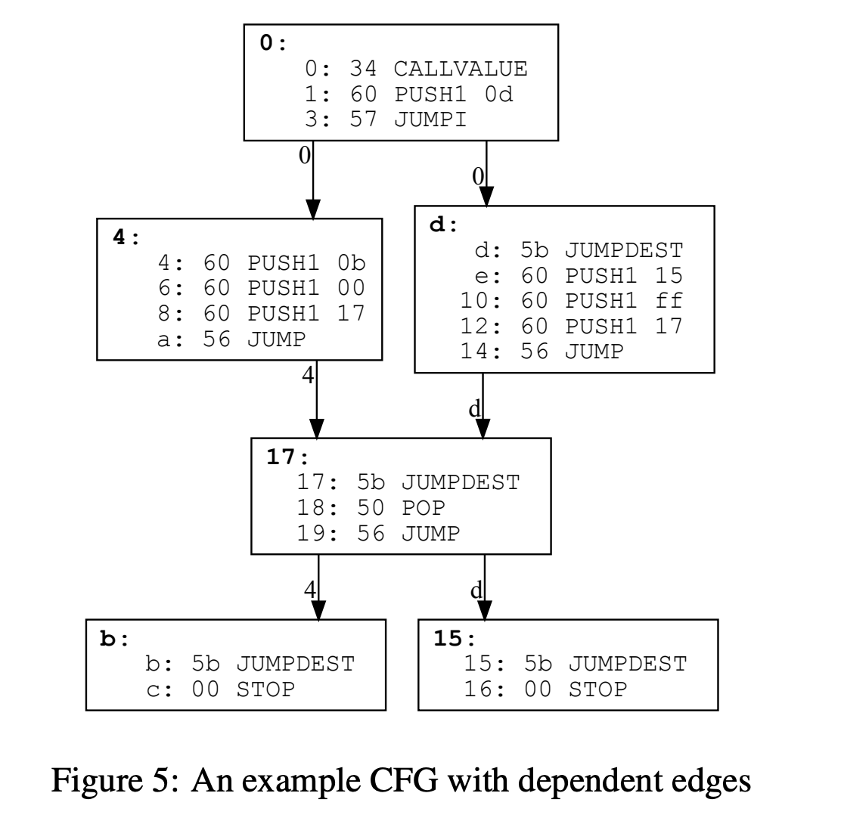
Novel solutions explored
CFG Recovery is done using backward slicing. This means generating edges iteratively and adding edges to the graph.
Teether reduces number of invalid paths by annotating edges with a block-level summary about the backward slices.
Constraint solving is performed using Z3 solver. Z3 was developed in the Research in Software Engineering (RiSE) group at Microsoft Research and is targeted at solving problems in software verification and program analysis.
The path generation module explores paths using the A* algorithm where cost = |branches traversed by path|.

Slide 15
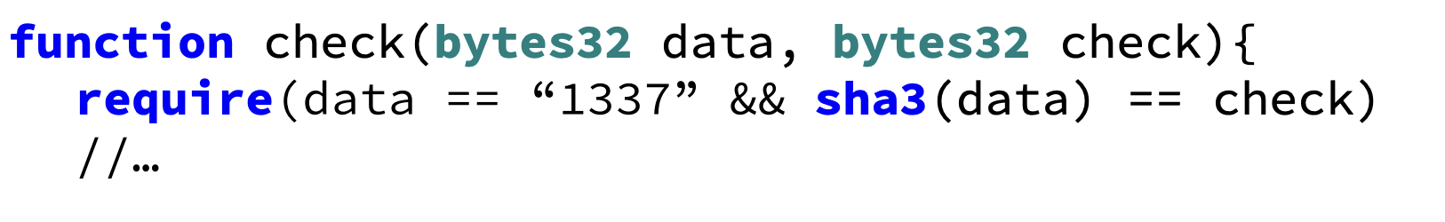
SHA3 instruction constraint
The code requires data == 1337 and sha3(data) == check
Z3 constraint solver cannot solve the sha3(x) == check because that means the hash can be reversed which is impossible.
To solve this, we can remove sha3(data) == check from the constraints and solve for data == 1337.
Once we get the result for this reduced constraint, we can compute sha3(data) and replace sha3(data) with the value produced by sha3(1337).
Now we repeat the process with the new constraints:
data == 1337 and 0x985d.. == check

Slide 16
contributions
The paper makes the following main contributions:
The authors define what makes a contract vulnerable based on specific EVM instructions.
They create a tool called TEETHER that can generate exploits for contracts based solely on their bytecode.
To achieve this, the authors overcome various EVM-specific obstacles, including new ways to deal with symbolic hash values.
The authors conduct a comprehensive analysis of 38,757 distinct contracts obtained from the Ethereum blockchain to identify vulnerabilities at a large scale.

Slide 17
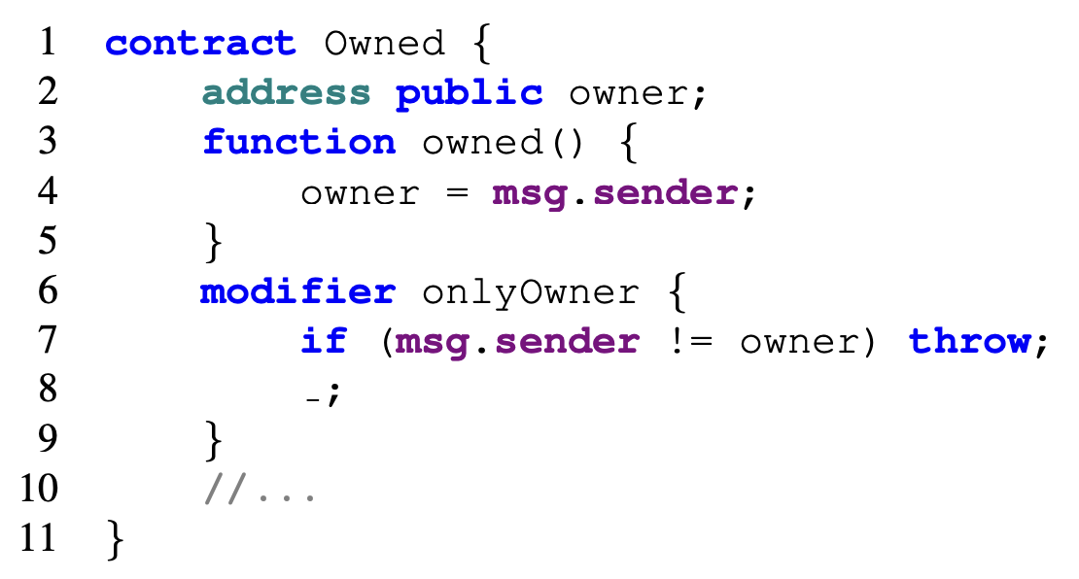
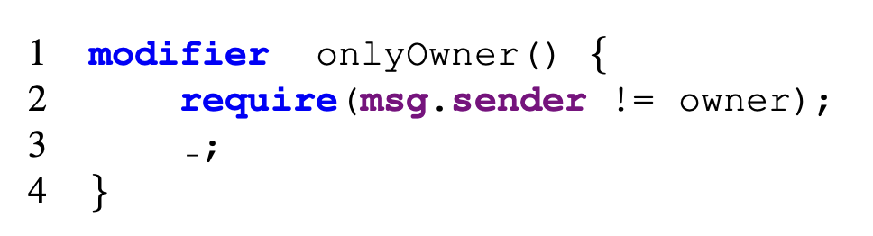
Problems detected in contracts
Vulnerabilities found in these contracts can be classified into four categories:
Erroneous visibility
Erroneous constructor
Semantic confusion
Logic flaws

Slide 18
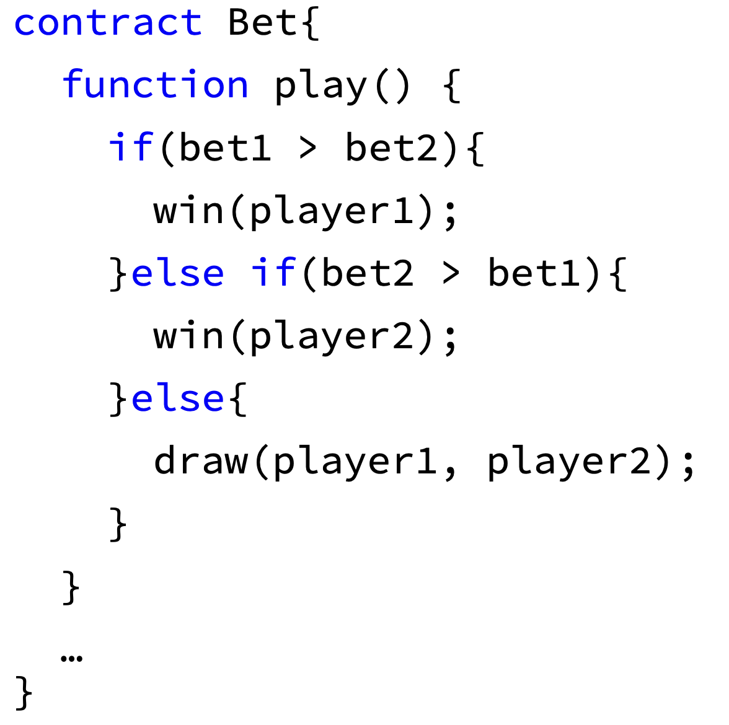
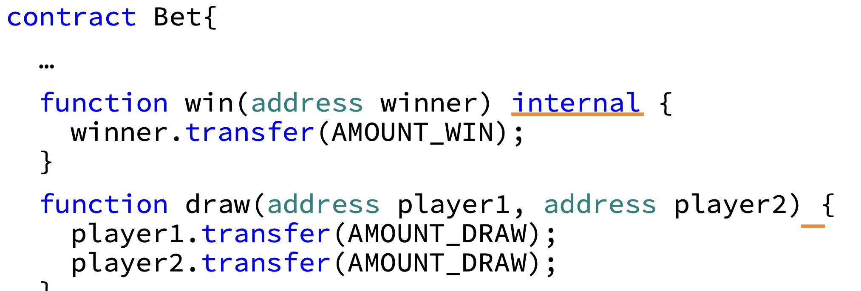
Problems detected in contracts

Slide 19
Re-implementation - Dataset Sourcing
The author provided a GitHub repository of the code along with running instructions but did not provide a dataset.
The author extracted the bytecode of 784,344 total contracts from blockchain in 2017 which requires a large amount of compute power and memory to replicate the state of the entire EVM.
After many failed attempts at trying to parse the current state of EVM and trying to use the EtherScan API for getting bytecode of deployed contracts we decided to adopt an alternate strategy.
We looked for datasets created by other vulnerability detection tools and we found a dataset: https://huggingface.co/datasets/mwritescode/slither-audited-smart-contracts/tree/main
We randomly picked 1000 contracts from the above dataset and performed our analysis on them.

Slide 20
Re-implementation - Additional Code & RESULTS
We started a GCP Compute Engine instance and installed Solidity compiler, teether and its dependencies.
We wrote a script to perform a timed run of the CFG generation for 20 mins followed by Exploit generation for another 20 mins on all the contracts.
In a previous attempt to source contracts, we also wrote HTML parsers to extract bytecode for contracts from the EtherScan website.
We discovered 12 contracts with vulnerabilities for which exploits were generated by this tool.
Compared to the original detection rate of 4.4% contracts, our re-implementation detected vulnerabilities in 1.2% of the contracts.
This is because of availability of significantly less compute power and reduced runtime for CFG and exploit generation.

Slide 21
Code run
Running script to generate exploits on all contracts and piping the logs to run3.log -
The above script runs teether tool to generate the Control Flow Graph for 20 mins followed by exploit generation for 20 mins.
The & at the end is used to run the process in the background.
The code will print symbolic execution of the bytecode which is used to detect all the paths which an execution can trace. We can see EVM low-level bytecode being analyzed to generate a control flow graph.
Let's look at the logs generated by the above command.

Slide 22
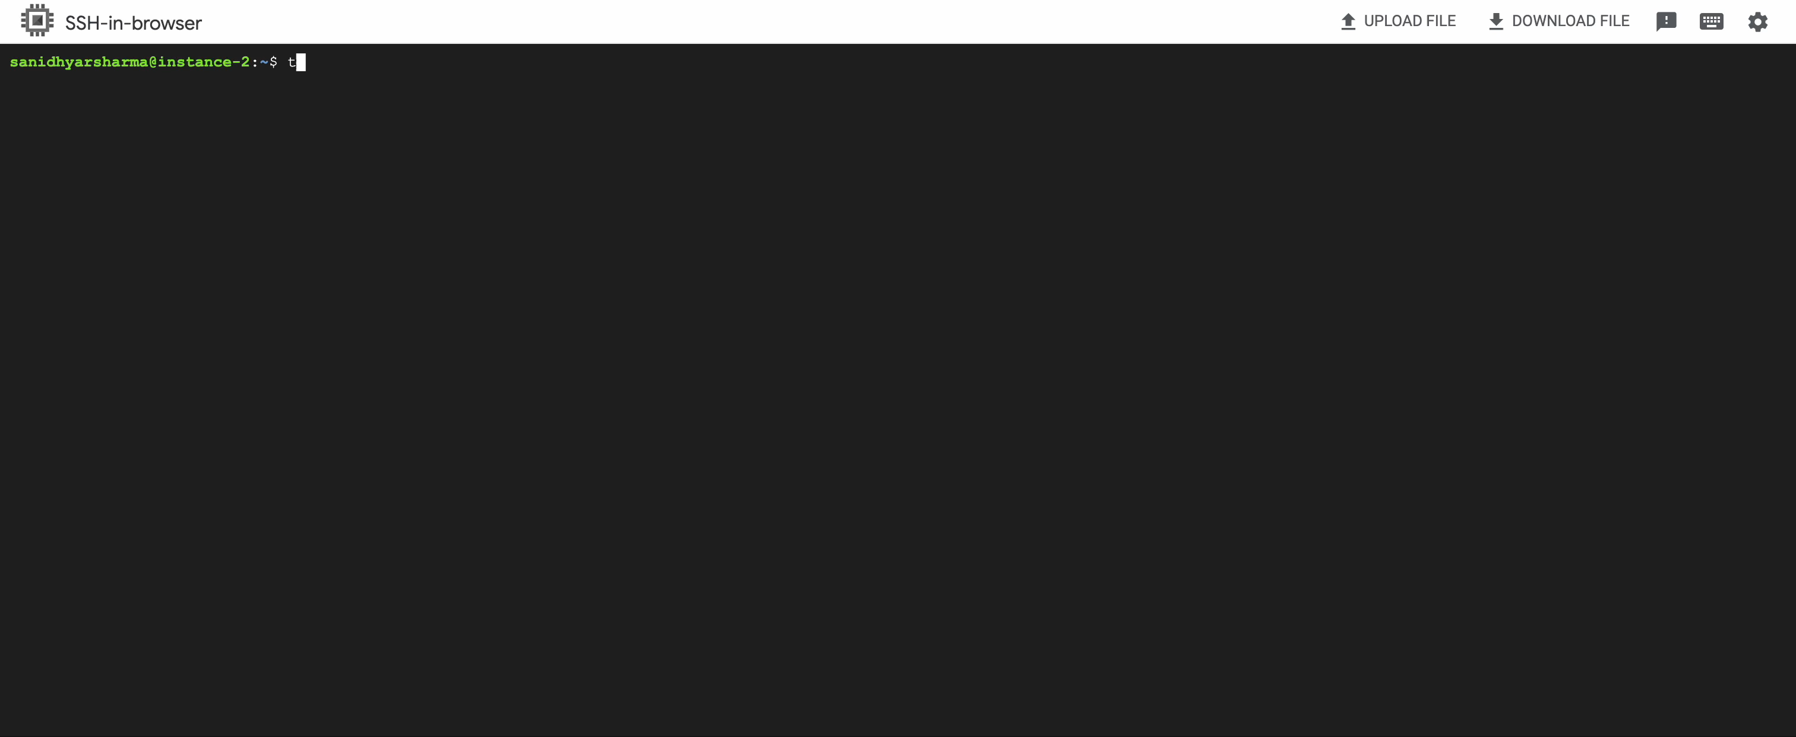
Re-implementation - VIDEo demonstration

Slide 23
enhancements
The enhancements that we added to this tool are:
Being able to automate the process of generating the CFGs from a large number of contract codes and generating exploits for each one of them.
A script to allow generation of exploits from newly deployed contracts on EtherScan. New contracts can be detected by checking for '0x60' in the starting bytes in the compiled bytecode.

Slide 24
learnings
Ethereum Virtual Machine: Solidity, Remix, Ganache, Bytecode, EtherScan.
CFG & Symbolic Execution: Control flow graphs can be used to symbolically execute code and understand the possible execution paths it can take.
Z3 Constraint Solver: SMT solvers and their ability to solve satisfiability problems.
A* Algorithm: Teether uses A* to generate the least costly paths first which is a good optimization to generate branches in problems which have a long runtime (high depth). Normal DFS approaches could take too long if the branch encountered first has a very long execution time. This heuristic approach improves the runtime a lot.
Importance of writing secure smart contracts because of their immutable nature.

Slide 25
THANK YOU
Sanidhya Sharma
shars05@pfw.edu
Anuradha Ramchandran
ramcas01@pfw.edu

